Slide 1
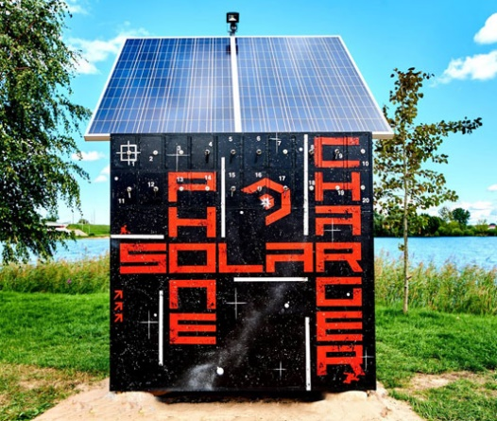
A Solar charger for mobile devices
Solar charging stations for smartphones, tablets and other portable electronics.
Ideal for Open Air fests, as well as summer cafes, bars, restaurants etc.
Useful both for visitors and hosts!
ALTENERGO LTD.
Latvia, Riga
www.altenergo.lv

Slide 2
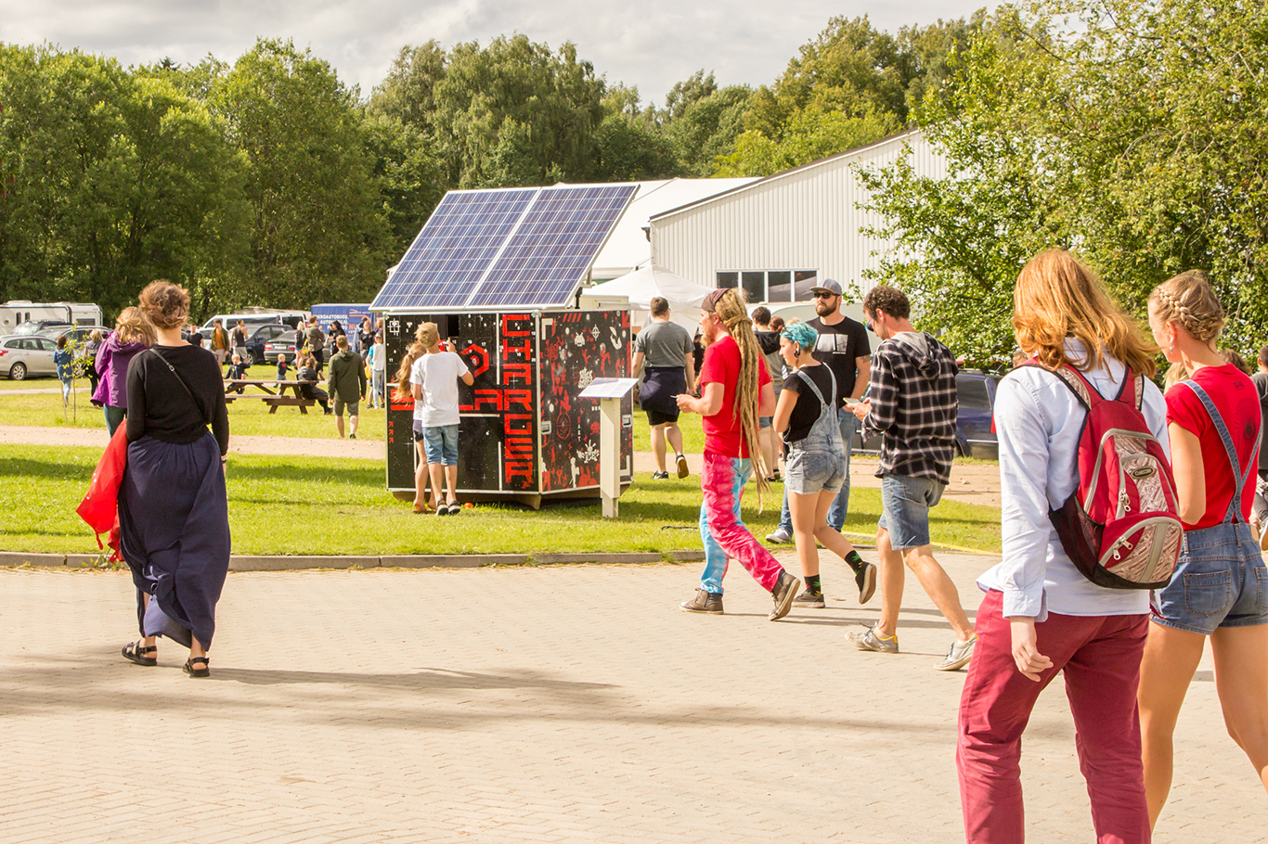
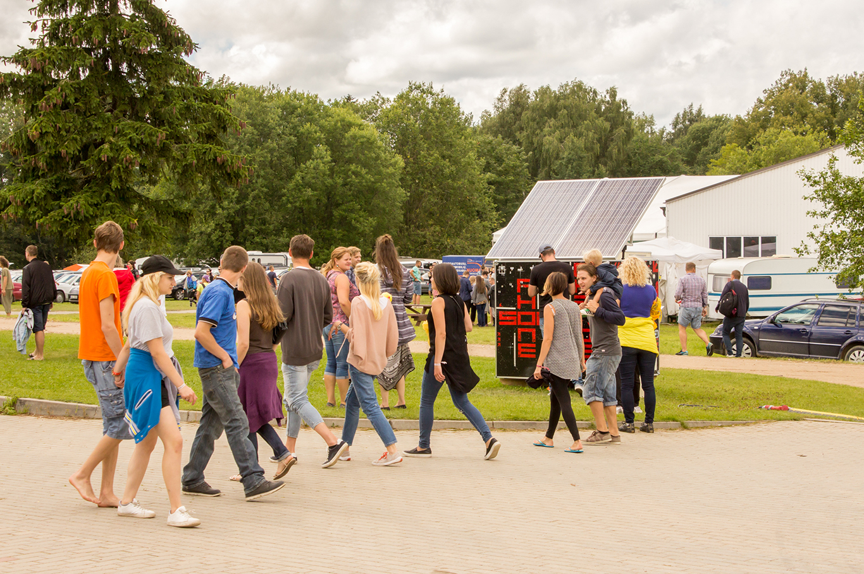
The solar charger is already tested
Our station was installed at several Open Air music festivals in Latvia. The demand was high!

Slide 3
Advantages of using the solar charger
Your guests will be even more satisfied with your events and services.
Mass-media will highlight the progressive eco-aspect of your enterprise.
A solar phone charger definitely attracts attention – it is perfect for placing advertisements.
Further options – the station can be equipped with a Wi-Fi access point, a video surveillance camera, a loudspeaker and charging devices for e-bikes, Segways and other personal electric transport.
You can also come up with your own ideas on how to upgrade the station – we can tailor-make it!

Slide 4
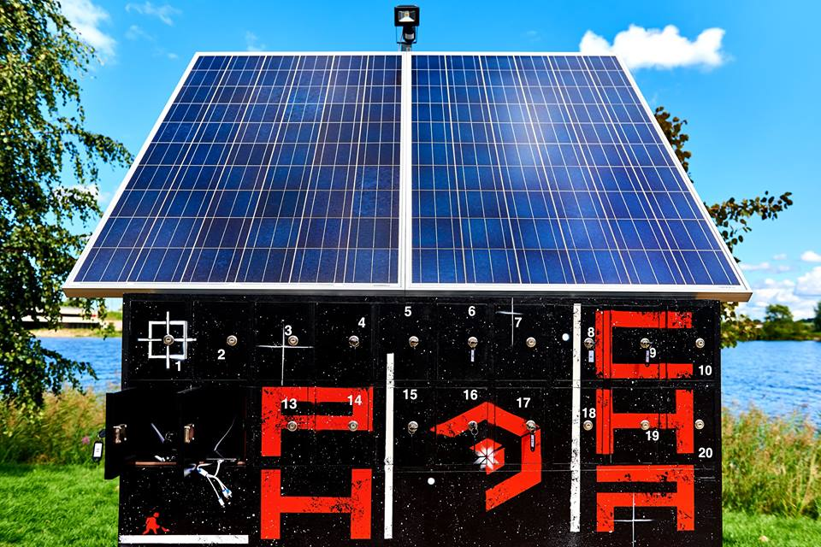
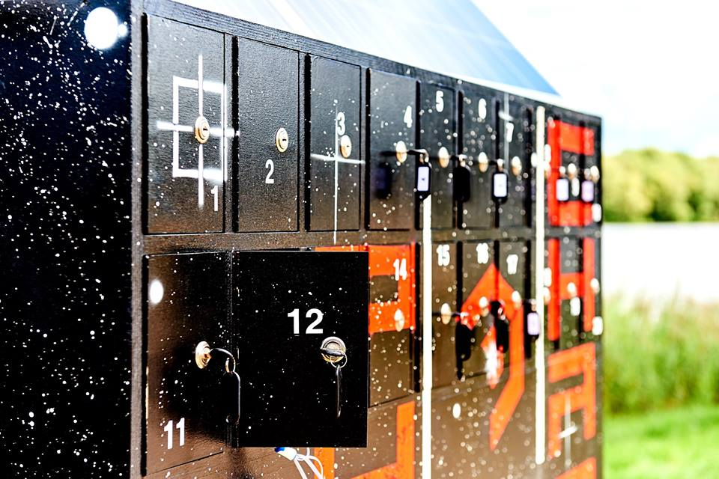
Scalability of the charge station
We offer custom solutions – amount of PV panels and charging cells, as well as capacity of the battery will be adjusted to your real needs!
Shape, size and decoration of the station are also up to you!

